Slide 1
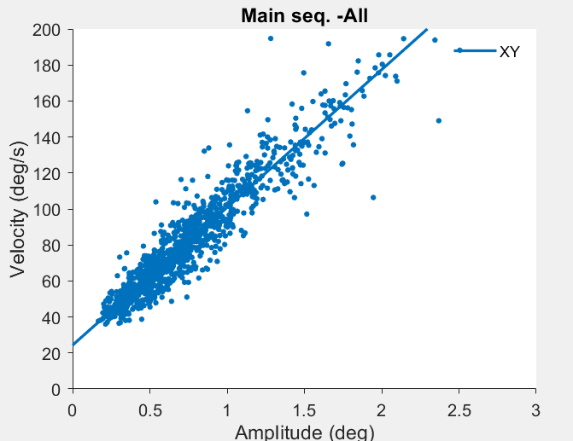
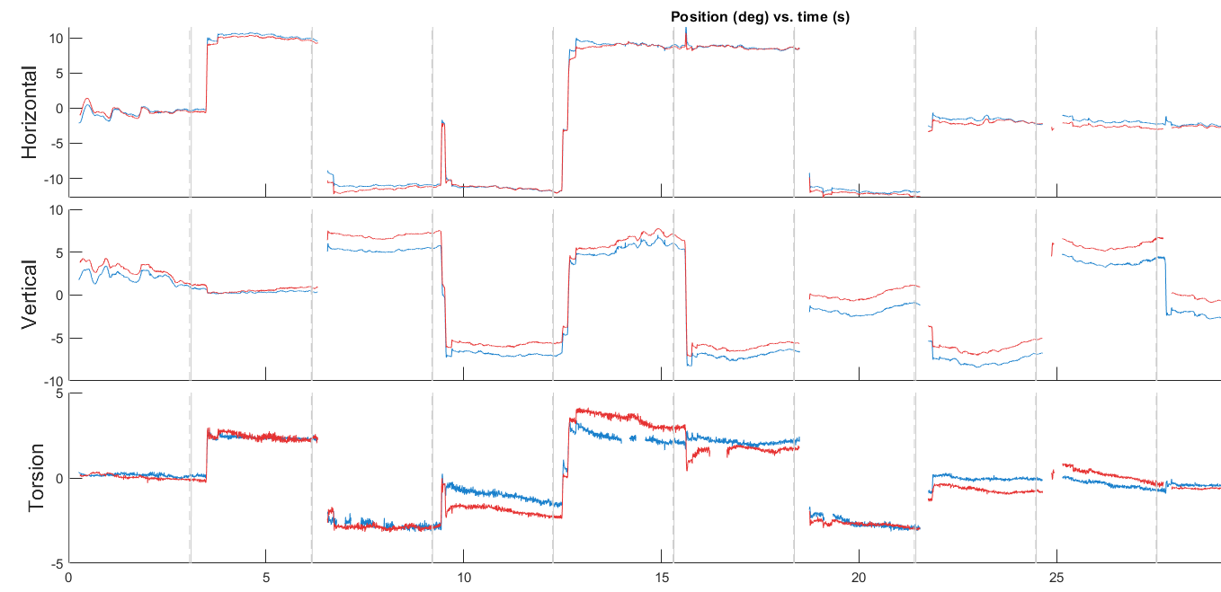
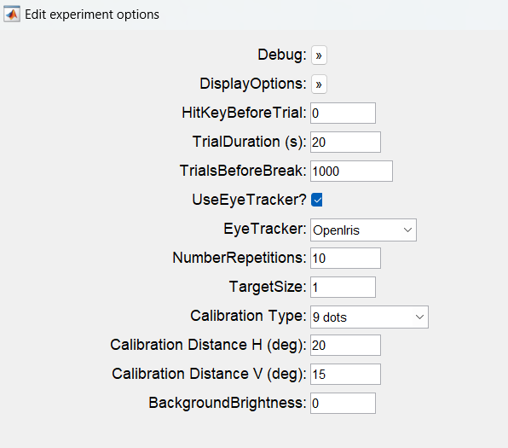
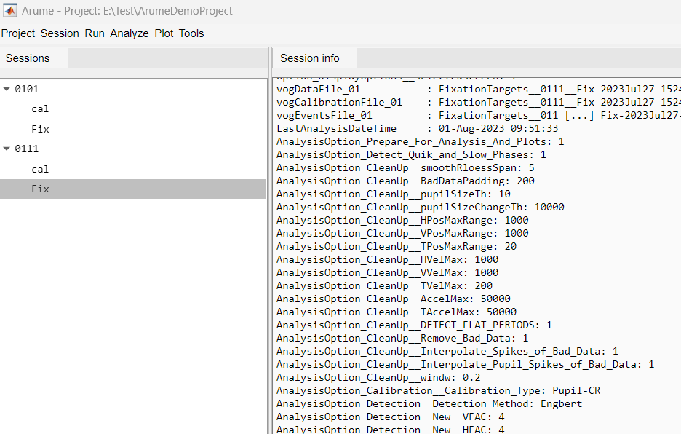
Arume

Slide 2
What is Arume?
A software framework to (hopefully) make life easier to anybody in the lab programming a new experiment. Based on Matlab and Psychtoolbox.
Takes care of some of the “boring” things when running experiment
Save and organize data
Provide a GUI
Start/stop/resume
Error handling
Randomization
Etc.
So the experimenter only has to define the conditions or trial table for the experiment and the code for running a trial

Slide 3
What is Arume?
Not just for running experiments. Also to analyze them.
Include some of the common and standard eye movement analysis and plots
Saccade detection
Nystagmus analysis
Etc…
Gives a framework to add new analysis and plots

Slide 4
What Arume is not
A wrapper around Psychtoolbox.
Still have to use the “Screen(….)” primitives to draw stimulus
(although should use the Arume wrapper for Flip)
A sophisticated Psychophysics engine
No staircases, quest, or anything like that implemented.
You have to do that yourself (for now)
A stable and mature bugfree piece of software

Slide 5
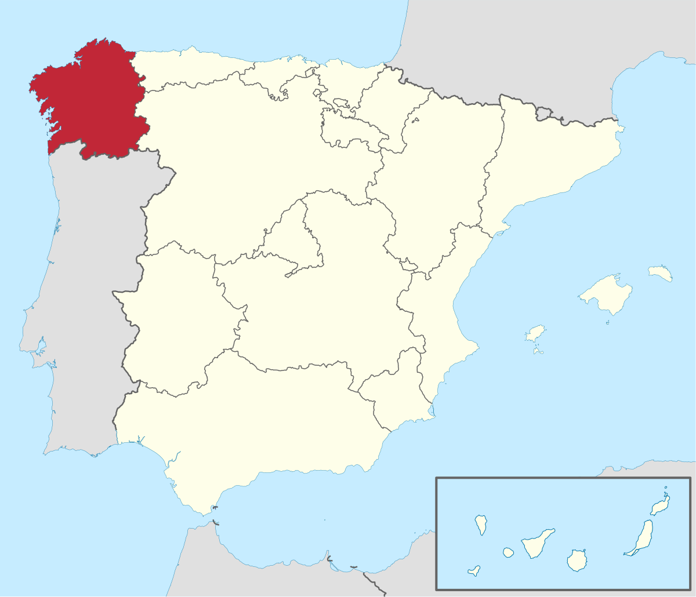
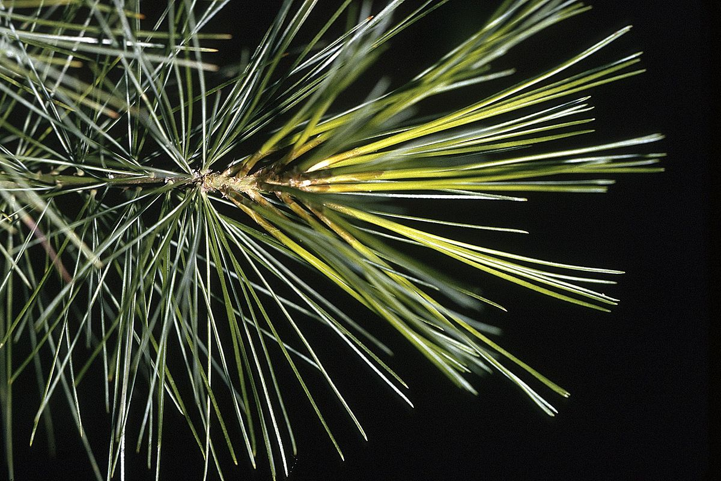
Why Arume? … because I like the word. And I thought it would be easy to pronounce and remember.
Galician Anthem
Que din os rumorosos
na costa verdescente, ao raio transparente do prácido luar?
Que din as altas copas de escuro arume arpado co seu ben compasado monótono fungar?

Slide 6
Demo1 – project – sessions - running
Add project
Add session
Run/restart/resume
Show folder structure

Slide 7
Demo2 – Data analysis

Slide 8
Demo3 – Session import

Slide 9
Demo3 – add plot

Slide 10
About MATLAB tables…
Just use them …
Introduced in matlab R2013b.
Replaced dataset which was introduced in
Gets a lot of the advantages of R or Python while keeping the good things of MATLAB.
Two previous MATLAB styles
Big matrix of numbers and a “col_names” variable to indicate what each column means.
Code full of data(:,cols.LeftX). It’s ok… but you need to know that the second variable exists and make sure they stay consistent.
Structures. Code full of data.LeftX. It’s ok… but getting sections of the data for multiple “columns” is cumbersome.
trialData.LeftX = data.LeftX(trialBegin:trialEnd);
trialData.RightX = data.RightX(trialBegin:trialEnd);
Tables!!!

Slide 11
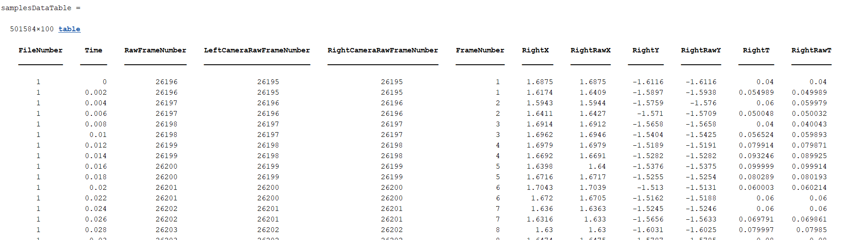
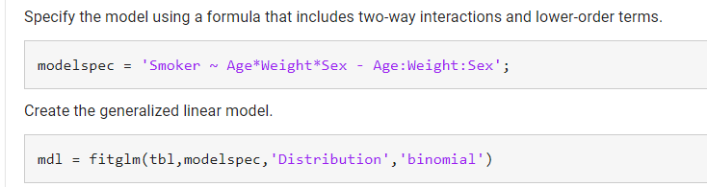
Tables!!!
Solve both problems!
Self consistent and documented. Columns have names!
Can access data in multiple ways.
data.LeftX works!
data(:,5) also works!
data(trialstart:trialend,{“LeftX”, “RightX”}) => parenthesis give you a sub table
data{trialstart:trialend,{“LeftX”, “RightX”}} => curly brackets give you a matrix
data(trialstart:trialend,:)
(this can be a problem, yes…, there are way too many ways)
Built to work with new stats matlab functions

Slide 12
Tables!!
Different from cells
In a cell variable each “cell” can be anything
In a table each column can be anything, but all the elements of a column must be the same type
Especially useful in combination with categorical variable types

Slide 13
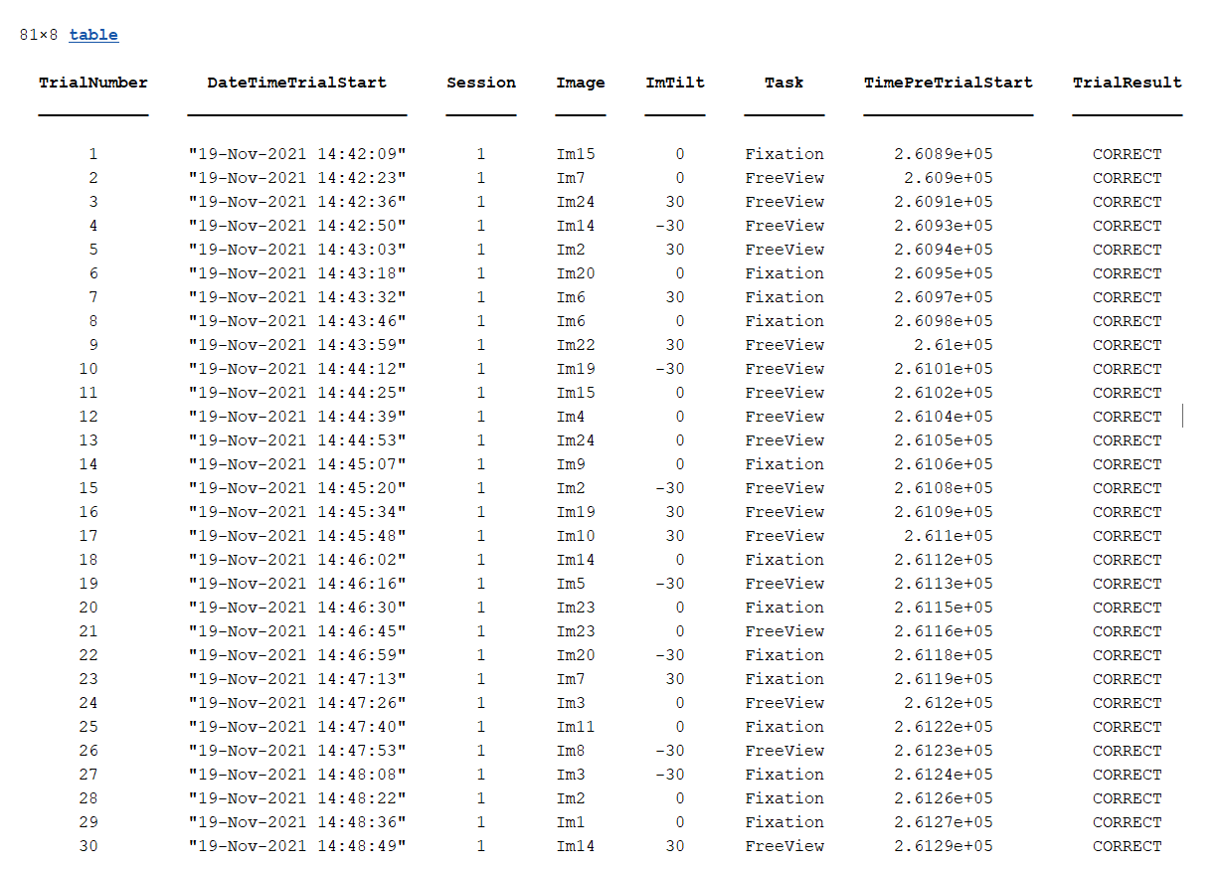
Tables!!!!!

Slide 14
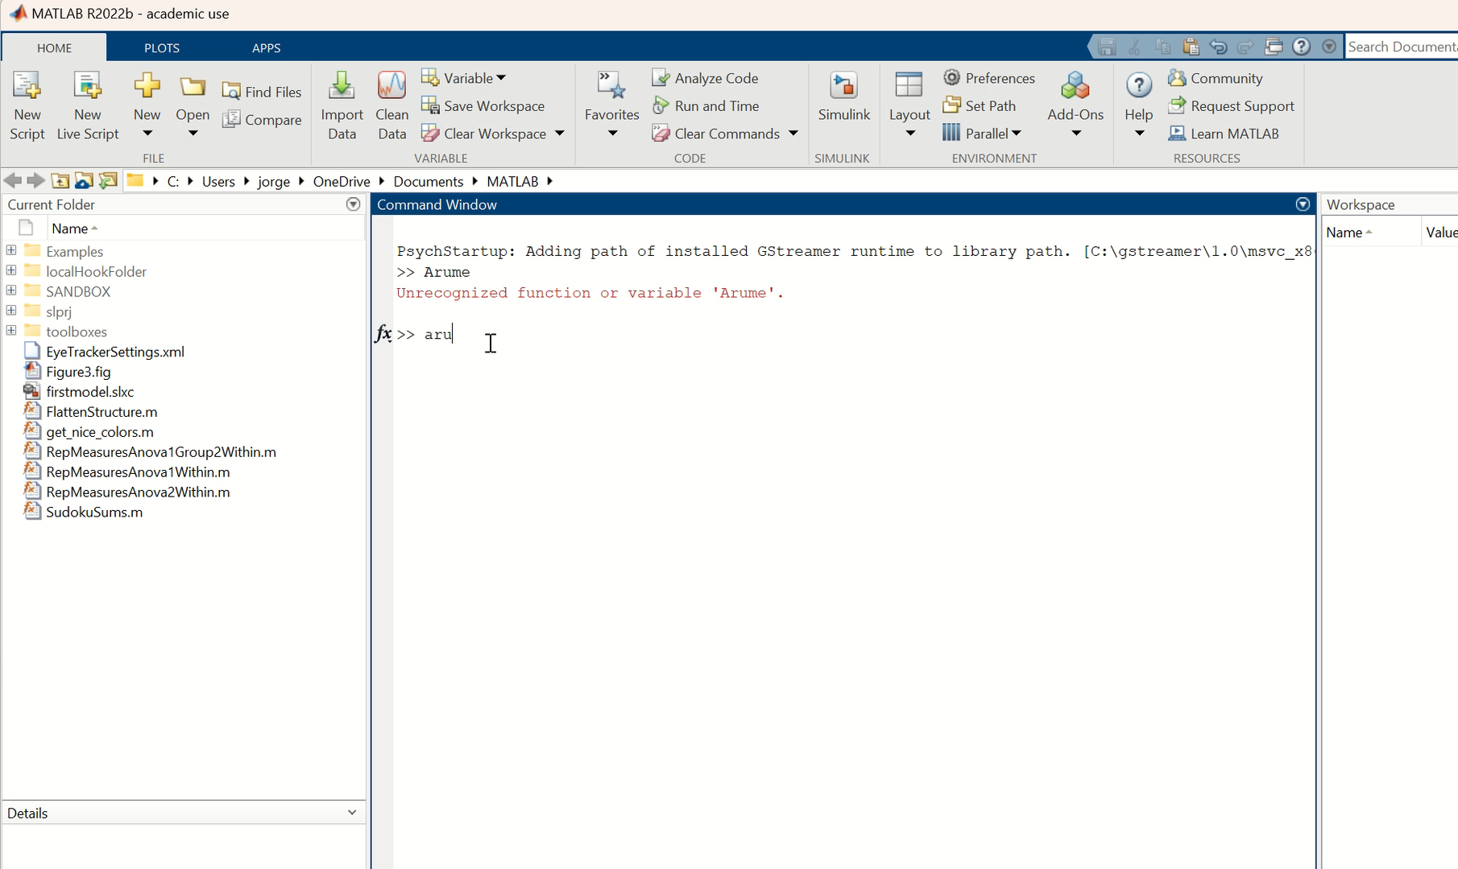
Arume setup

Slide 15
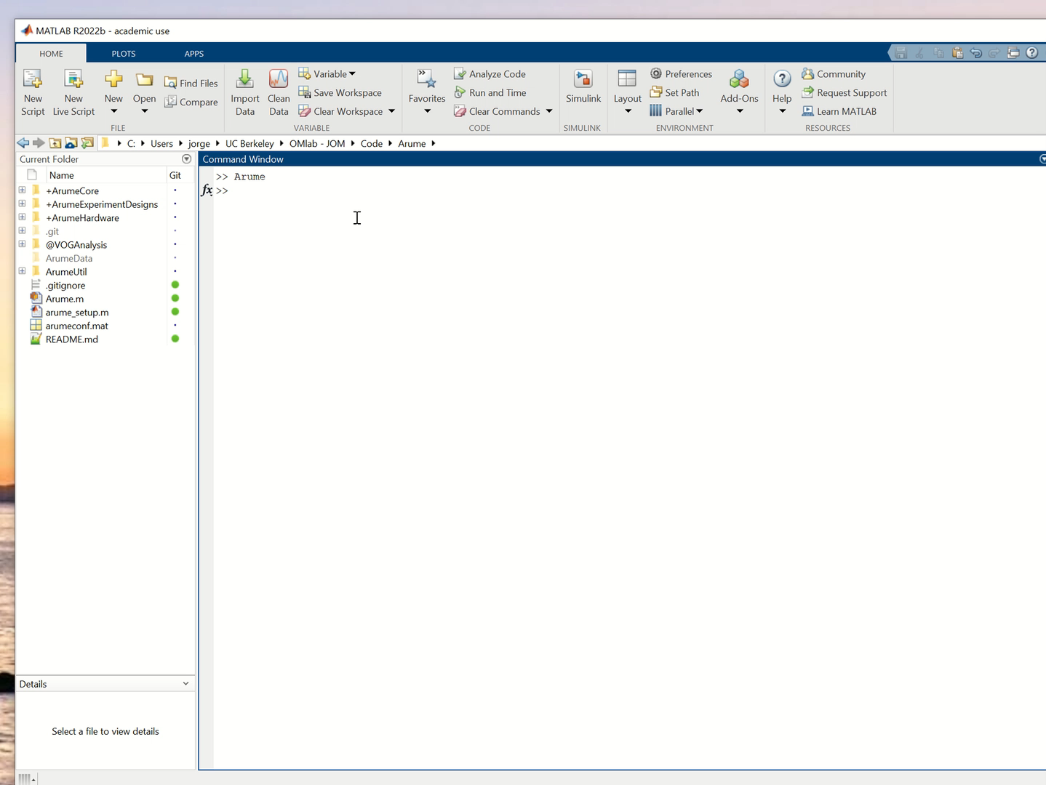
Arume – setup – start – new project

Slide 16
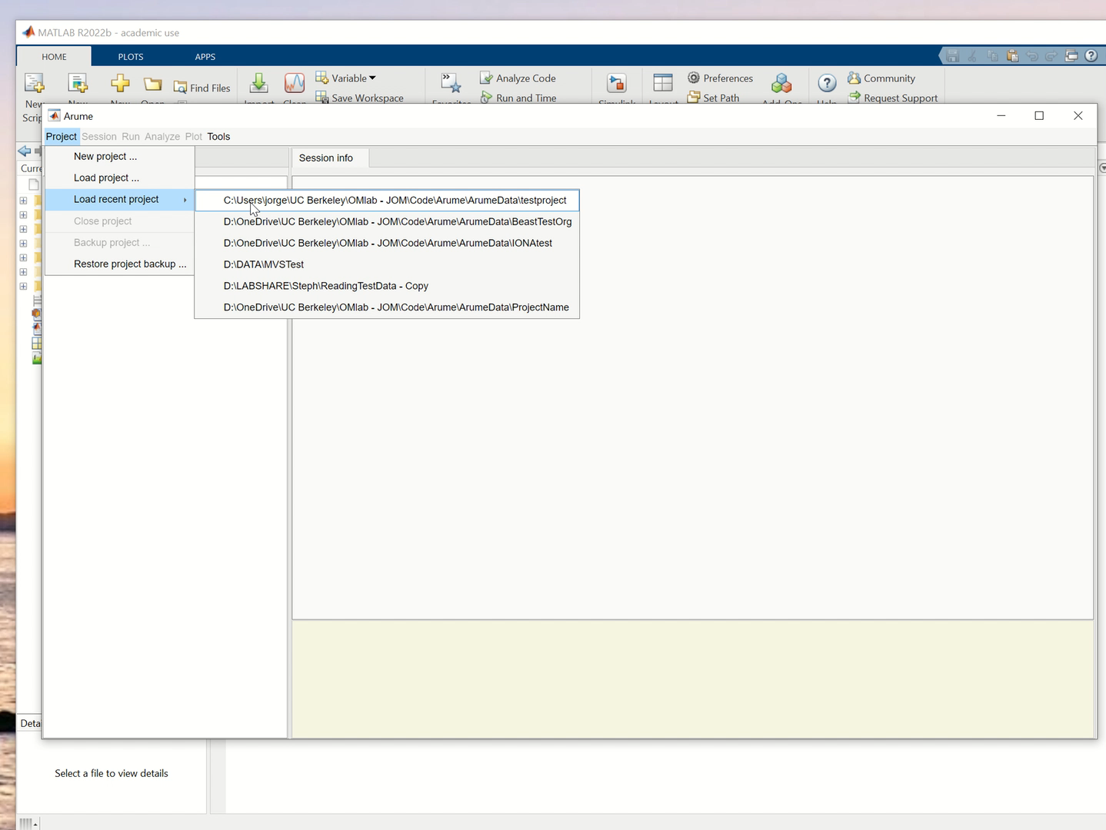
New session

